Slide 1

IBM COGNOS TO ANALYSE AND VISUALIZE NEW YORK CITY BIKE RIDE SHARE DATA

Slide 2

TEAM MEMBERS MEKALA PRAVEEN (19UK5A0508) KAVATI ANANTHESHWAR (19UK5A0515) B.VASANTH NAIK (17UK1A05F8)

Slide 3

CONTENTS
ABSTRACT
OBJECTIVES
INTRODUCTION
PROJECT FLOW
WORKING WITH THE DATASET
LOADING THE DATASET
ARCHITECTURE
HARDWARE REQUIREMENTS
ADVANTAGES AND DISADVANTAGES
CONCLUSION
FUTURE ENHANCEMENT

Slide 4
ABSTRACT
Many bike share systems make available their trip data for those who want to understand how their systems are used. The bike share system in New York City, Citi Bike, is one of them. The trip data files contain one record for each ride, around two million records per month, depending on the season. It’s a traditional bike share system with fixed stations where a user picks up a bike at one dock, using a key fob or a code, and returns it at another. The station and time when the ride started and stopped is recorded for each ride. Some limited information about the rider is also recorded: their gender and year of birth.

Slide 5
OBJECTIVES
Know fundamental concepts and can work on IBM Cognos Analytics.
Gain a broad understanding of plotting different graphs.
Able to create meaningful dashboards

Slide 6
INTRODUCTION
IBM Cognos is a business intelligence tool for web-based reporting and analytics. IBM Cognos to Analyze and Visualize New York City Bike Ride Share Data goal is to create an operating report of Citi Bike for the year 2018. In this, we’ve to create data visualizations to understand,
Total number of trips
What is customer and subscriber with gender
Find the top bike used with respect to trip duration?
Calculating the number of bikes used by respective age groups.
Top 10 Start Station Names with respect to Customer age group.

Slide 7
PROJECT FLOW
Users create multiple analysis graphs/charts.
Using the analyzed chart creation of Dashboard is done.
Saving and Visualizing the final dashboard in the IBM Cognos Analytics.
To accomplish this, we have to complete all the activities and tasks listed below.
IBM Cloud Account
Login to Cognos Analytics
Working with the Dataset
Understand the Dataset
Loading the Dataset
Data visualization charts
Problem Statement 1: Number of trips
Problem Statement 2: Percentage of Subscribers and Customers
Problem Statement 3: Bike Usage
Problem Statement 4: Age Group differentiation by Bike
Problem Statement 5: Top 10 Start Station Names with Customer age group
Dashboard Creation
Export the Analytics

Slide 8
WORKING WITH THE DATASET
The data was sourced from the Citi Bike’s amazon server. We should download the data and understand it. Now, let’s see a brief overview of what each feature represents or should represent.
1. Trip Duration (seconds) — How long a trip lasted
2. Start Time and Date - Self-explanatory
3. Stop Time and Date - Self-explanatory
4. Start Station Name - Self-explanatory
5. End Station Name - Self-explanatory
6. Station ID - Unique identifier for each station
7. Station Lat/Long - Coordinates
8. Bike ID - unique identifier for each bike
9. User Type (Customer = 24-hour pass or 3-day pass user; Subscriber = Annual Member) - Customers are usually tourists, subscribers are usually NYC residents
10. Gender (Zero=unknown; 1=male; 2=female) - Usually unknown for customers since they often sign up at a kiosk
11. Year of Birth - Self-entered, not validated by an ID.

Slide 9
LOADING THE DATASET
Before we can build a view and analyze our data, we must first connect the data to IBM Cognos.
Cognos supports connecting to a wide variety of data, stored in a variety of places.
The data might be stored in our computer in a spreadsheet or a text file, or in a big data, relational, or cube (multidimensional) database on a server in our enterprise.
In our case, we will be using a spreadsheet or text file for making our analysis.

Slide 10
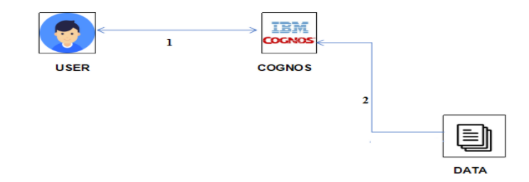
ARCHITECTURE

Slide 11
HARDWARE REQUIREMENTS
IBM CLOUD ACCOUNT
IBM COGNOS ANALYTICS
IBM CLOUD ACCOUNT
IBM Cloud is a suite of cloud computing services from IBM that offers both platform as a service (PaaS) and infrastructure as a service (IaaS). It includes many interacting components and systems for resource, user, and access management. A service ID identifies a service or application similar to how a user ID identifies a user. We can use a service ID that we create to enable an application outside of IBM Cloud to access our services. The IBM Cloud and its available services have allowed us to accelerate innovation and drive growth in our AI system.

Slide 12
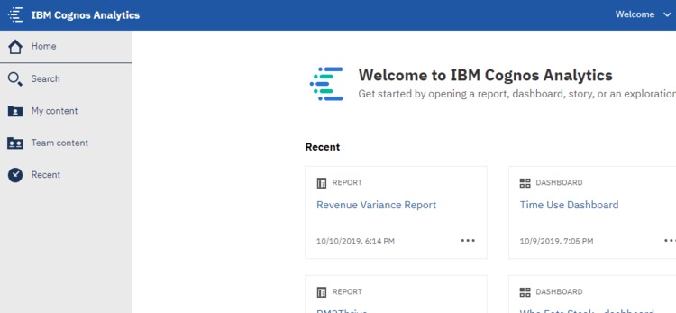
IBM COGNOS ANALYTICS
IBM Cognos is a business intelligence tool for web-based reporting and analytics.
It is a online based Bi tool.
Bi(Business Intelligence) is a set of processes, architects and technologies that convert raw data into meaningful information
The various features of IBM Cognos are Dashboard Creation, Reporting, Analysis, Data Integration etc.

Slide 13
ADVANTAGES AND DISADVANTAGES
ADVANTAGES :
Safety improvement for bikers.
It will encourage using bikes more often.
Good for tourists who want to explore the city.
In all, the times and routes of rides follow commuting trends, suggesting that the bikes are used primarily for utilitarian purposes.
Most rides take place during weekdays, with peak hours during 8 to 9 a.m. and 5 to 7 p.m., and follow similar traffic patterns as cars.
Better air quality.
Less particle pollution.

Slide 14
DISADVANTAGES :
Plenty of planning required.
Rides drop during colder months, rainy days and particularly on days with any snow at all.
Supervision is still necessary with current capabilities and regulatory approval.

Slide 15
CONCLUSION
The City Bike trip data, while useful for analysis as provided, can be made more so with some data preparation to add additional columns with more or less detail. And even though Citi Bike was designed for transportation it also gets used for recreation as evidenced by the number of trips that end up back where they start and the trips entirely on an island in the harbor. Pandas provides the data structures and operations to facilitate data preparation and Seaborn makes it very easy to produce distribution charts to understand the data. Jupyter Notebook provides a convenient way to document the preparation steps used.

Slide 16
FUTURE ENHANCEMENT
City Bike trip data can be combined with data from other sources to provide more insights into how the bike share system is used.

Slide 17

THANK YOU!

